Slide 1

Privacy Laws and Regulations
Student’s Name
Course
Professor
Date

Slide 2
Overview
Introduction
Analysis of privacy laws and regulation
Ethical considerations related to these laws/regulations
Family Educational Rights and Privacy Act (FERPA)
Health Insurance Portability and Accountability Act (HIPAA)
European Union (EU) Data Protection.

Slide 3
Introduction
Privacy laws are important and have to be followed strictly
Such laws include Family Educational Rights and Privacy Act (FERPA), Health Insurance Portability and Accountability Act (HIPAA), and European Union (EU) Data Protection.
Strict adherence to such regulations is needed
There are many challenges linked to respecting such regulations.
Non-compliance at times attracts hefty penalties.

Slide 4

Family Educational Rights and Privacy Act (FERPA)
It was legislated in 1974
Guards the privacy of student’s personally identifiable information.
The act is applicable to all educational institutions that receive federal funds.
FERPA is a law that grants parents certain rights with regards to educational records of their children (Fuller, 2017).

Slide 5

FERPA Privacy Compliance Requirements
Parents or eligible students have a right to request the right school records.
The parents have right to inspect and review students educational records
For information to be released, schools must have written permission (Fuller, 2017).

Slide 6

FERPA organizational compliance Challenges & Role of ethics
Some challenges include use of forged documents.
Non-compliance by some staff and allowing access
Leaking of the information anonymously
False pretense and identity
Personal ethics have to an individual to follow the regulations (Fuller, 2017). .

Slide 7
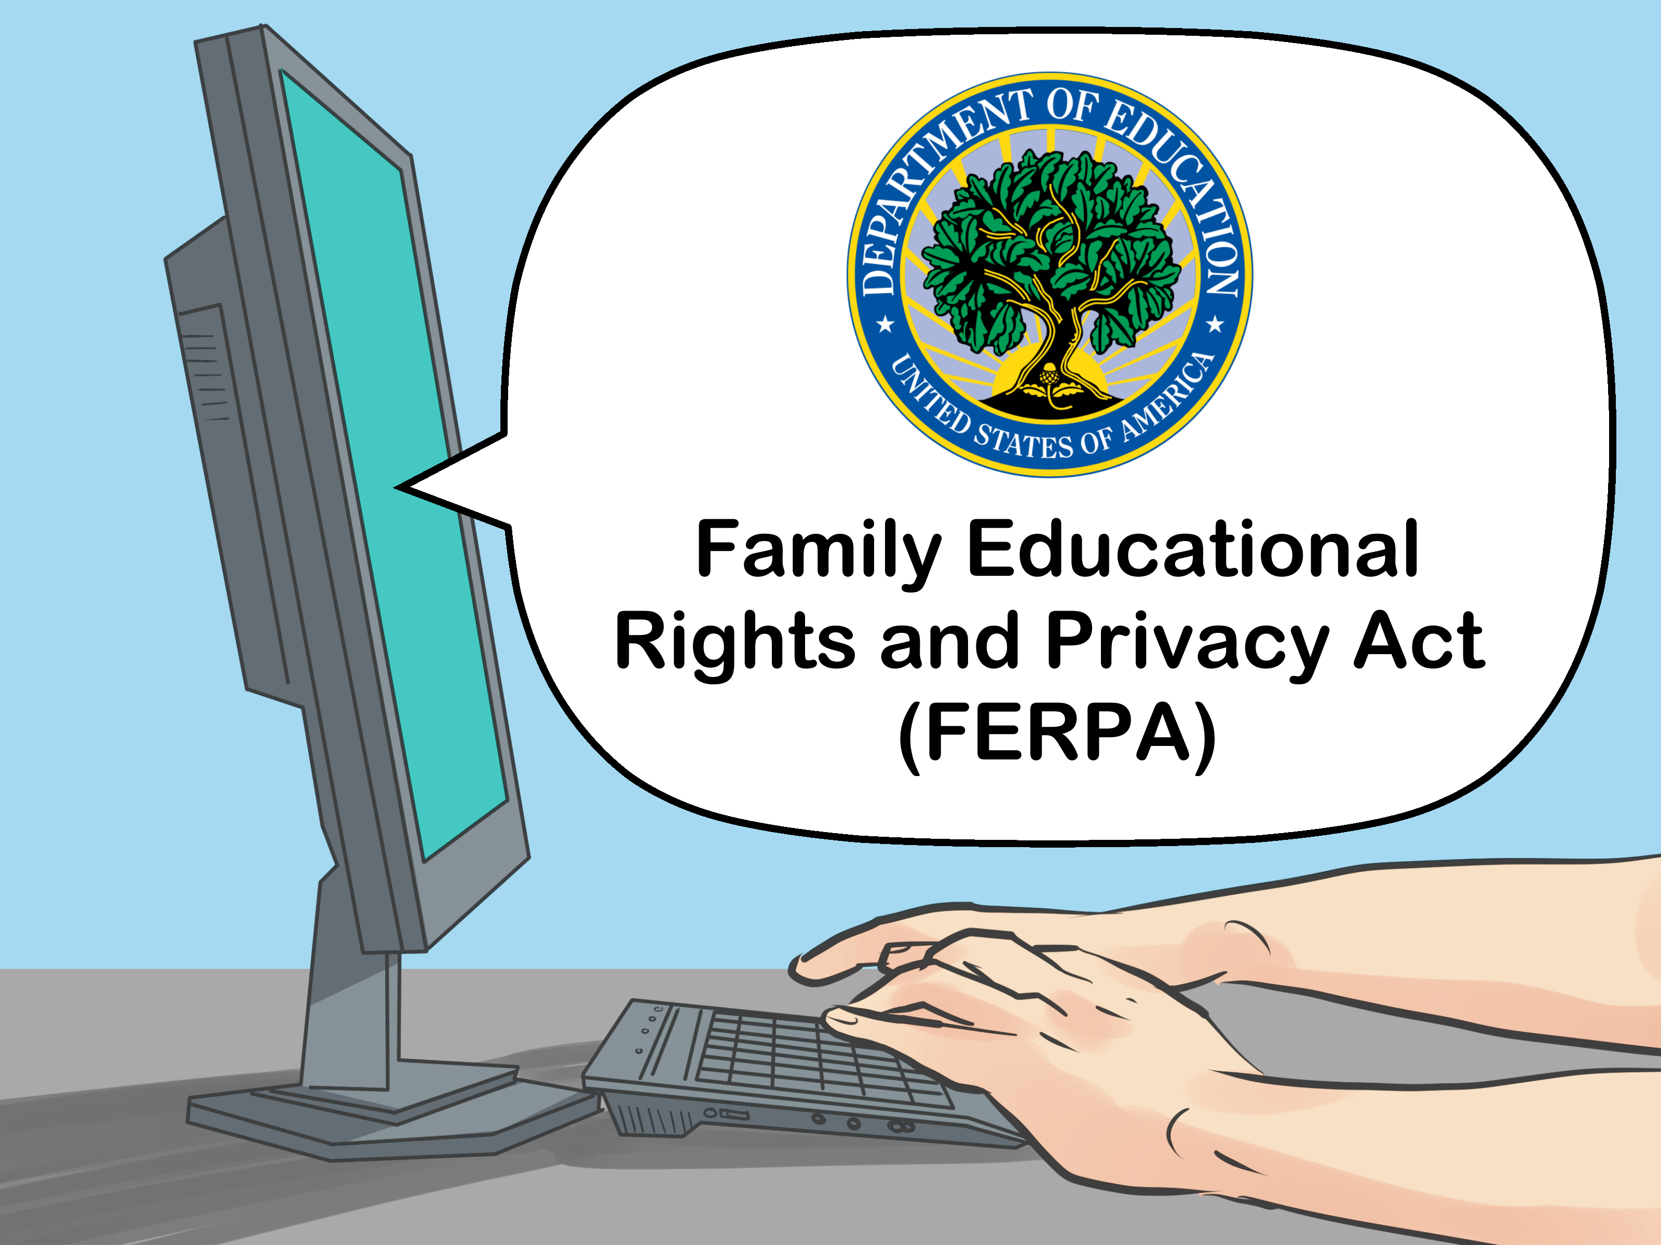
Penalties for Non-compliance of FERPA
Withdrawal of US Department of Education funds
Litigation due to disclosure as well as reviewing and investigating complaints.
Fines of up to $ 1000 or jail sentence not exceeding 6 months or both.
Dismissal of the staff responsible (Fuller, 2017).

Slide 8

Health Insurance Portability and Accountability Act (HIPAA)
It was passed in 1996
It is divided into 5 titles
Title I: The act protects health insurance coverage for workers and families when the change of lose jobs.
Title II: Prevents Health Care Fraud and Abuse
Title III: Offers guidelines for pre-tax medical spending
Title IV: Provides modification for health coverage
Title V: Governs company owned insurance policies (Garner, 2018).

Slide 9
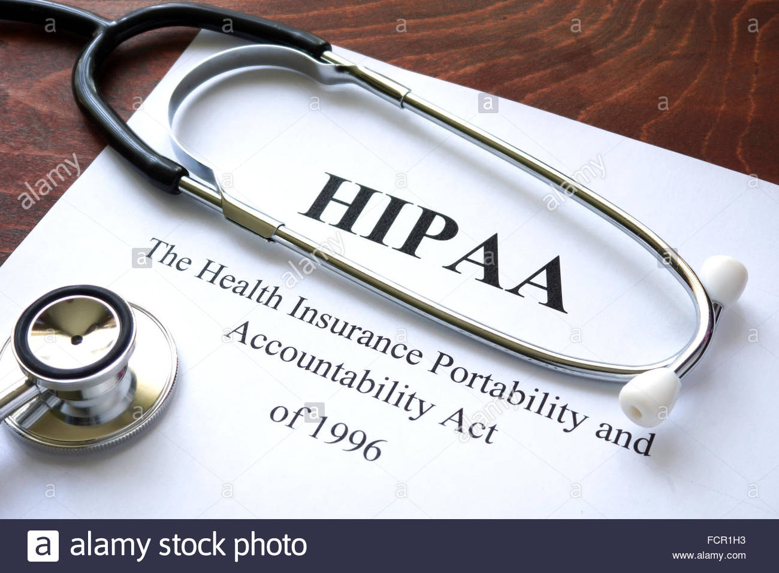
HIPAA Privacy Compliance Requirements
The act is aimed at keeping health information protected and private
It creates confidentiality system active within and even beyond health care facilities.
Patients data is confidential and should be protected physically, in network, and process security .
Compliance is mandatory for healthcare professionals, business associates, and subcontractors(Garner, 2018).

Slide 10
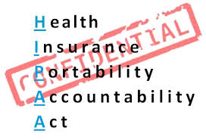
HIPAA organizational compliance Challenges & Role of ethics
Some challenges may include information being leaked by staff.
Information may also be used by hackers for extortion
It is ethical to maintain trust between healthcare and patients
Confidentiality is crucial to ensuring that the patients have received the desired level of care(Garner, 2018).

Slide 11

Penalties for Non-compliance of HIPAA
Violation of HIPAA may attract a penalty of $100 to $ 50,000 per record.
Violation may result to jail term
The maximum penalty per year may be $ 1.5 million
Fines and charges are broken down to willful neglect and reasonable cause.
Termination of service for individuals leaking the information(Garner, 2018).

Slide 12

European Union (EU) Data Protection.
Passed in 2016
It gave the EU citizens right to the protection of their personal data.
It strengthened individual fundamental rights in this era.
The law made sure that people have more control over their personal data
It also ensured that businesses benefitted from a level playing field (Mendelson, 2018).

Slide 13

Penalties for non-compliance
Fines as high as 4% global annual revenues
The fine charged can be of 20 Million Euros
Legal obligation for parties that have failed to comply

Slide 14

Recommendations: Improvement of the regulation
Foster heavy penalties for persons/companies who fail to adhere to these rules.
The compliance can be increased through creating awareness.
Encourage compliance and good morals of people/firms.
Form agencies to oversee the strict adherence to these regulations

Slide 15
References
Fuller, M. (2017). An Update on the Family Educational Rights and Privacy Act. New Directions for Institutional Research, 2016(172), 25-36.
Garner, W. (2018, June). FERPA, HIPAA, and Other Privacy Concerns in Online Education. In EdMedia+ Innovate Learning (pp. 519-523). Association for the Advancement of Computing in Education (AACE).
Mendelson, D. (2018). The European Union General Data Protection Regulation (EU 2016/679) and the Australian My Health Record Scheme–A Comparative Study of Consent to Data Processing Provisions.

Slide 16


